Slide 1
U.S. Army Warrant Officer Career College
Command Overview Update
United States Army Warrant Officers Association
20 October 2022
Current as of: 26 JUL 22

Slide 2
Agenda
USAWOCC Structure
USAWOCC Modernization
  Meeting the needs of Army 2030
  WO PME Modernization – Modernizing the Continuum
  WOCS Redesign – Getting the Foundation Right
Discussion

Slide 3



USAWOCC Organization
TRADOC
CAC
ArmyU
Religious Support
Commandant USAWOCC
Sharp
Equal Opportunity
Deputy Assistant
Commandant (ARNG)
Knowledge Mgmt/Futures
Deputy Commandant USAWOCC
Safety
Deputy Assistant
Commandant (USAR)
S-1
Director of Education & Training
1st WOC
DOET
Quality Assurance
S-2/3
HHC
TAC Officer Certification Course
Academic Operation Division
Academic Instruction Division
AOD
AID
S-4
Registrar/
Student Services
Mission Command & Leadership
Registrar/
Student Services
Communications &
Management Sys Dept
Academic Research Chair Mission Command & Leadership
S-6
WOCS
Course Director
Department of Strategy and Doctrine
WOCS
CRSE Director
Joint Interagency and Multinational Operations Dept
Academic Research Chair Department of Strategy and Doctrine
WOACC
Course Director
Applied Military History
Office of the Commandant
WOSSE
CRSE Director
International Strategic Systems Dept
Academic Research Chair Applied Military History
Coordinating Staff
WOILE
Course Director
Core Function Lead
WOILE
CRSE Director
Special Staff
WOSSE
Course Director
Coordinating Line
POC: CW3 Mitchell (S-1)
christabelle.m.mitchell.mil@army.mil
Current as of: 21 JUN 22

Slide 4
Mission & Faculty
Mission:
Train, educate, and prepare Warrant Officer Candidates for appointment to WO1. Educate and train Army Warrant Officers in the grade of CW2-CW5, at key points in their careers, in order to apply their technical expertise in support of leaders at the tactical through strategic levels. IAW TR 10-5-4 and ICW TRADOC, CAC, and Army University, serve as the TRADOC executive agent for Warrant Officer common core education.
Faculty:
Mix of military, DA Civilian, and Contractor
  TACs all military
  Academic instructors are approx 40% Civilian: Prior Army, Navy, Marine Corps, Air Force, & Coast Guard
Three Academic Departments support five courses (WOCS, WOAC-CC DL, WOILE, WOSSE, TOCC)
    Mission Command & Leadership (MCL)
    Department of Strategy & Doctrine (DSD)
    Applied Military History (AMH)
Accreditation:
  TRADOC Accreditation- Previous Accreditation JAN 21/ Next Accreditation JAN 24
POC: CW3 Nalls (S-3)
cornelius.u.nalls.mil@army.mil
Current as of: 18 JUL 22

Slide 5
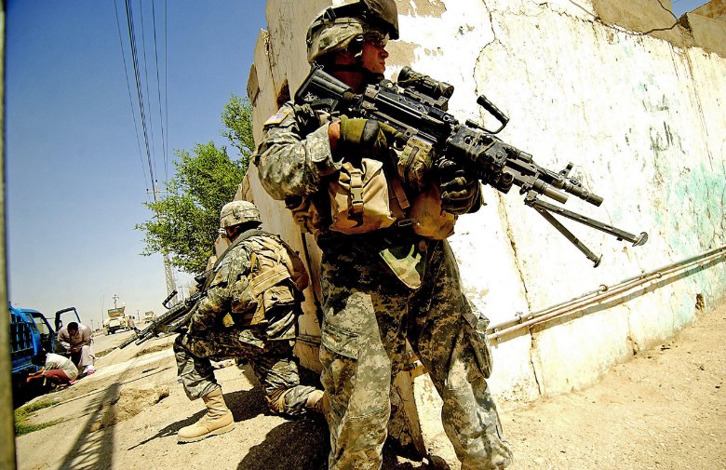
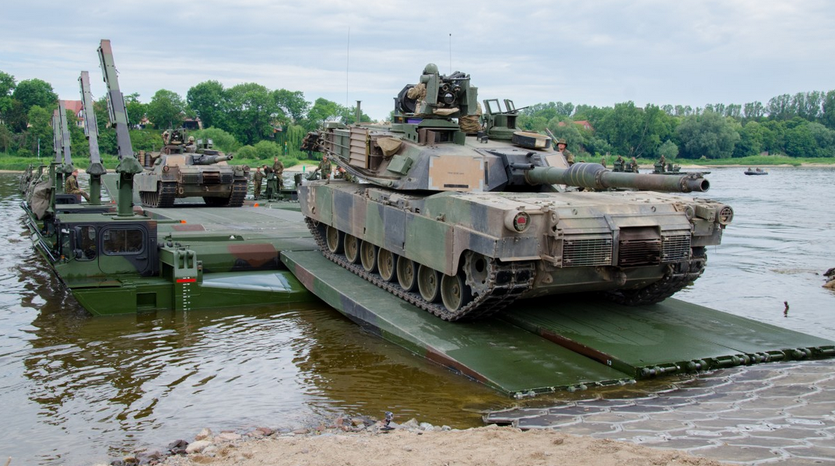

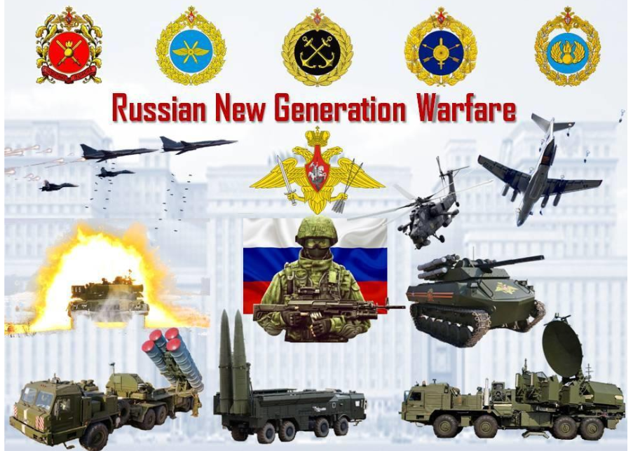
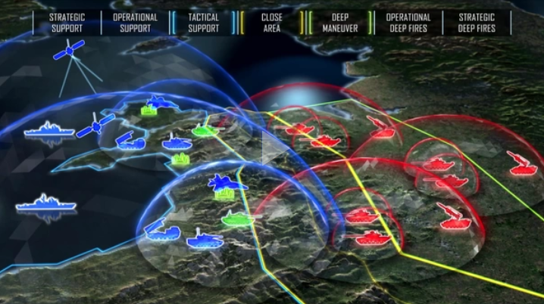

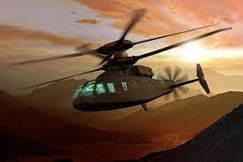

Army Modernization
Current Environment
Army Addresses Gaps
17 LSCO Gaps (Min Growth)
Integrating Future
Capabilities (Significant Growth)
Army optimized for COIN rotations
Army re-focuses on LSCO
Army 2030: MDO-Capable
WFF sliced to BCTs for COIN
DIV/Corps not formations; LSCO capabilities limited
Doctrine, Organizational, Training, and Leadership changes to optimize for LSCO
“Landing Spots” for materiel updates
Masses combat power at division and corps levels
CAC LSCO Study
Russian aggression in Ukraine
NK2 War
Chinese aggression in SCS
Adversaries building asymmetric A2AD capabilities
Army develops
Multi-Domain Operations
MDO-Ready
ADA
Precision missiles
EW and cyber
Information technology revolution
Cyber
Space
Data
Artificial Intel
Materiel solutions integrated
Refined doctrine, organizational, and training changes
Sets conditions for Army 2040
Integrates space, cyber domains
Evolution of combined arms doctrine – FM 3-0
LSCO against a peer threat is also a Total Army, echeloned fight, which required analysis not only for the Division as a formation, but the capability and capacity of our Corps and priority Theater Army Headquarters to enable convergence and access to joint and multi-national capabilities.

Slide 6
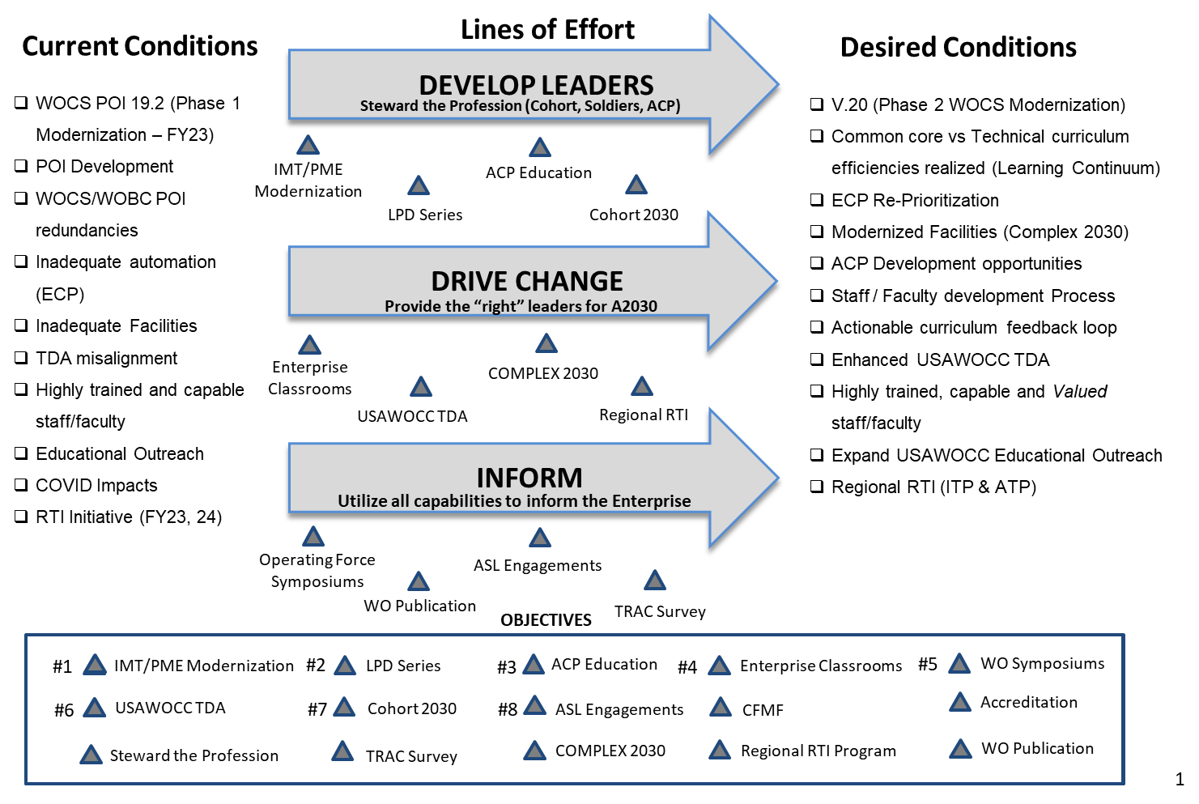
USAWOCC Strategy 2030

Slide 7




Common Core / PME
5 Phased Modernization Planning Phases
Current Continuum
SME
SME
SME
Communicator
Communicator
Operations
Operations
Advisor
WOBC
WOAC
WOSSE
  Leadership
  Operations
  Communications
  Advisor
  Operations
  Communications
  Leadership
  Advisor
  Operations
  Communications
  Leadership
  Advisor
  Operations
  Communications
  Advisor
  Leadership
  Advisor
  Communications
  Operations
  Leadership
  Advisor
  Communications
  Operations
  Leadership
WOCS
WOACC (DL)
WOILE
Operations
Advisor
Leader
Communicator
Communicator
Operations
SME
SME
FY23
FY24
FY25
FY26
WOCS POI 19.2
WOCS POI 20.0
Requirements
Submission
FOC
Modernized Continuum
SME
SME
SME
Operations
Communicator
Communicator
Communicator
Advisor
Advisor
  Leadership
  Operations
  Communications
  Advisor
WOBC
  Operations
  Communications
  Leadership
  Advisor
  Integrator
WOAC
  Operations
  Communications
  Leadership
  Advisor
  Integrator
WOMC (DL)
  Operations
  Communications
  Leadership
  Advisor
  Advisor
  Communications
  Operations
  Leadership
  Integrator
  Advisor
  Communications
  Operations
  Leadership
  Integrator
  Operations
  Communications
  Advisor
  Leadership
  Integrator
WOCS
WOIC
WOSC
WOMC
Operations
Communicator
Communicator
Operations
Advisor
Leader
SME
Communicator
Operations
SME
SME
Phase I
Phase II
Phase III
Phase IV
Phase V
Technical Training – CAC / Centers of Excellence / Branches
Warrant Officer Common Core - USAWOCC

Slide 8
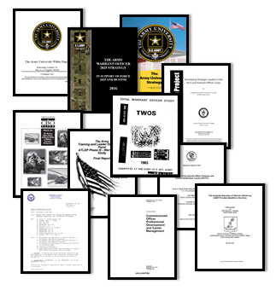
WOCS Modernization
Current State
Problem: The current Warrant Officer Candidate School training and education does not provide the optimal level of knowledge and skills in Warrant Officer/Company Grade common-core to prepare WO1s to face the new and emerging challenges and complexities of the current and future operational environment.
Research
and
Studies
38 years of looking
at the Warrant Officer
Modernization End State
A more rigorous training and education environment with a seamless acculturation process in the WO IMT experience that ensures WO1s have the necessary competencies to support Army 2030 and beyond.

Slide 9
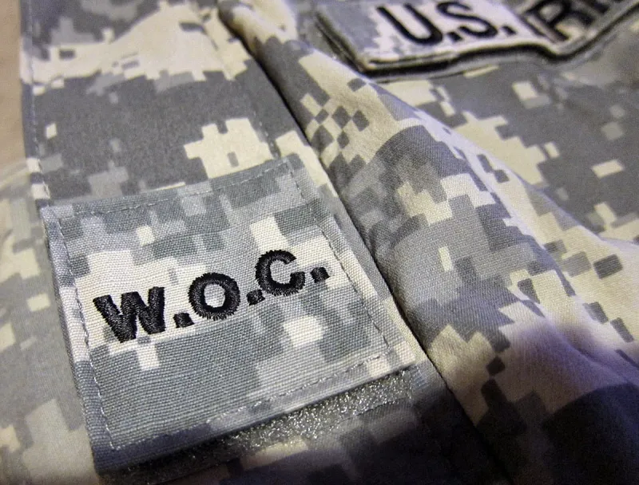
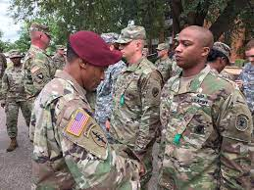
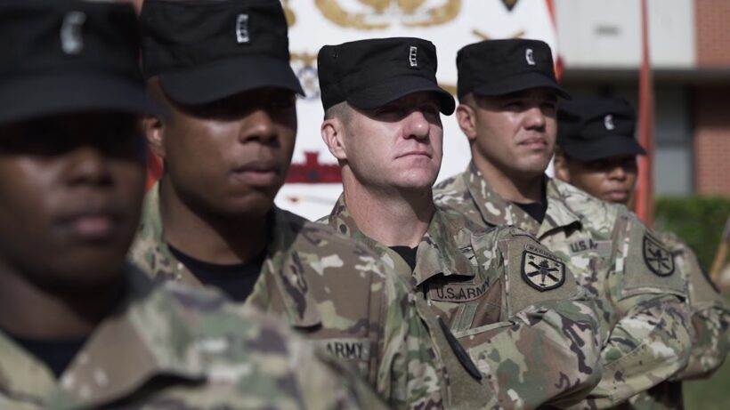
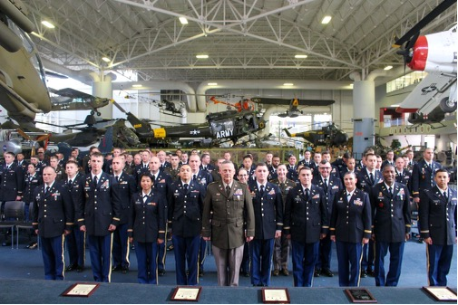
WOCS Comparison
2002-2022
2023-2030
CURRENT COURSE
FUTURE COURSE
WO1s not fully prepared to face emerging challenges of the future fight
Majority of the material designed for lower cognitive level outcomes
83% of WOCS students are prior enlisted Soldiers who have completed BLC/ALC or SLC.
Not designed to address current PME levels of the majority of students (ALC graduates)
Structured to provide IMT for Soldiers who are new or have little experience in the Army
COEs duplicate education and training during WOBCs
Defines a more distinctive transition of Soldiers into an officer/WO1s
Enhances/increases cognitive rigor in support of holistic warrant officer development as curious lifelong learners
Relevant to generational talent
Demonstrates organizational investment in personal and professional growth
Instills the warrant officer identity at the foundational level
Establishes doctrinal competency
Optimized course structure that increases Warrant Officer capabilities within current resource constraints
Provides COEs with a more mature and doctrinally sound WOBC Student
Allows WOBC to dedicate more time for technical system integration training/education
Informs Army WO PME modernization across the learning continuum

Slide 10












WOCS Future Concept
Module A
Module B
Module C
Module D
Who am I?
Students focus on WO Leadership Development, Army Profession and Organizational Communication.
Why am I HERE?
Students study the Doctrine, Military Operations, through the lens of applied Military History in order to advise leaders.
How do I INTEGRATE?
Students learn the principles of planning, critical thinking and problem solving IOT enhance system integration in support of military operations.
How will I CONTRIBUTE?
Students apply learned competencies to perform their WO duties and responsibilities as integrated members of their organizations.
~83% have graduated some level of NCOES.
30 TDs
~12% are high performing enlisted soldiers with desired skills & traits.
WO Acculturation Process
Civilians
~5% are high performing civilians with education, preferred skills or experience.
I. Leadership
II. Communications
III. Operations
IV. Integrator
V. Advisor
Warrant Officer Core Competencies
WOCS Outcomes
BOLC Outcomes
~100%
WOBC
FUA
Army Learning Areas (ALAs) / General Learning Outcomes (GLOs)

Slide 11
Why we exist….
Video Placeholder

Slide 12
Questions / Discussion
COL Kevin E. McHugh (Commandant)
CW5 Julian Evans (Deputy Commandant)
5302 Outlaw Street
Fort Rucker, AL 36362
334-255-3869
334-703-1189

Slide 13
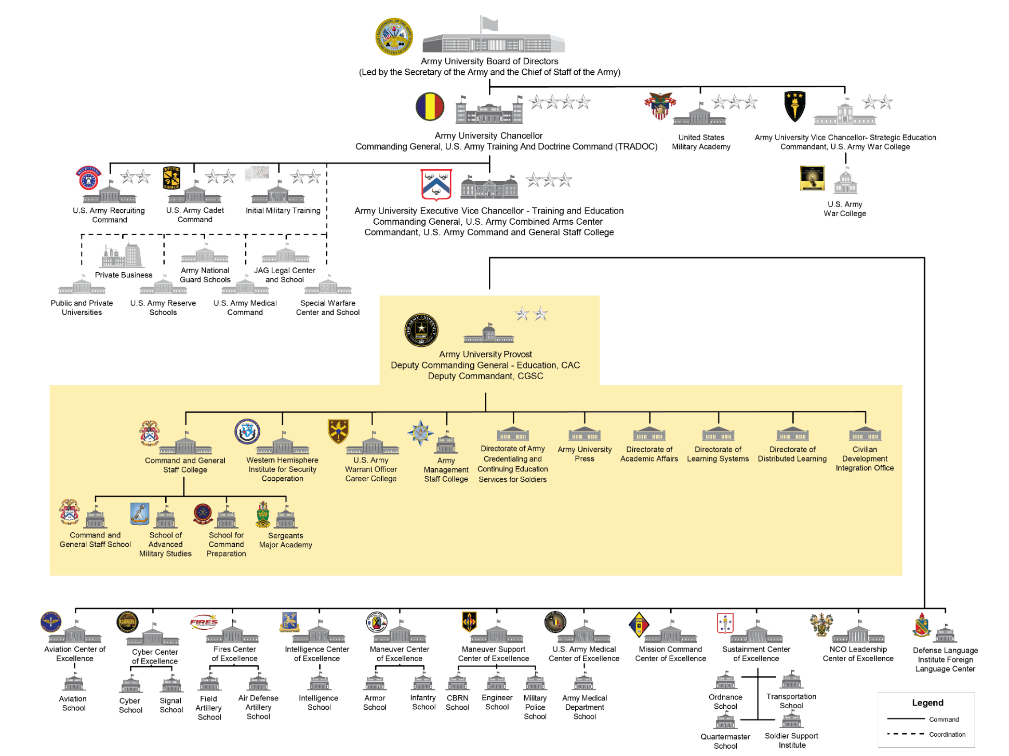

Army University Structure
POC: CW3 Nalls (S-3)
cornelius.u.nalls.mil@army.mil
Current as of: 21 JUN 22

Slide 14
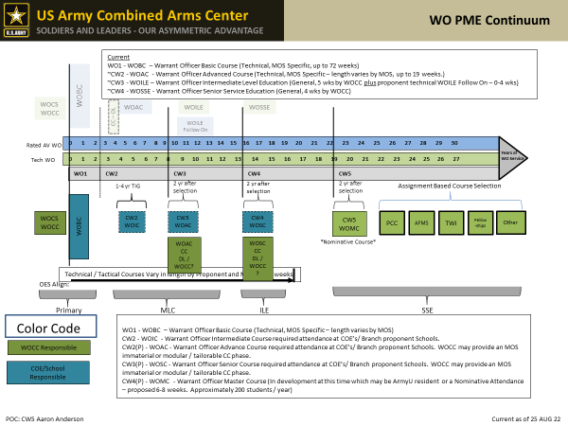

Slide 15
Warrant Officer Education Continuum
School | Warrant Officer Candidate School | Warrant Officer Basic Course | Warrant Officer Advanced Common Core | Warrant Officer Advanced Course | Warrant Officer Intermediate Level Education | Warrant Officer Senior Service Education | TAC Officer Certification Course
Proponent | CIMT | Branch | WOCC | Branch | WOCC | WOCC | WOCC
Rank | Candidate | W01 | CW2 | CW2 | CW3/CW4 | CW4/CW5 | CW2/CW3/CW4
Officer Equivalent | Officer Candidate School | Basic Officer Leadership Course | Captains Career Common Core (CCCC) 75 DL Hours | Captains Career Course | Command & General Staff College (ILE) | Senior Service College | Platoon Trainer Qualification Course
Length | 5 weeks or 6 months | 4 to 39 weeks | 1 Week (18 DL Hours) | 4 to 20 weeks | 5 weeks | 4 weeks | 3 Weeks
Web-based Prerequisite | No | No | No | Yes | No | Yes | Yes
Students | 2546 | 1,995 | 4000 | 1,700 | 840 | 360 | 28
Outcomes | Officer Leadership | Technical Tactical Leadership | Leader Dev Mission Cmd Joint Ops Army Ops | Technical Tactical Staff Skills | Joint Tactical/ Operational Staff Skills | Joint Strategic Staff Skills | Leader Dev IMT Standards Counseling Cadre Instructor
POC: Dr. Jennifer K. Gray (DOET)
Jennifer.k.gray.civ@army.mil
Current as of: 18 JUL 22

